Slide 1
Lesson 2: The client–server model
Mack 2023
Notes:
Last updated 30-11-2021
Resources are updated regularly — the latest version is available at: ncce.io/tcc.
This resource is licensed under the Open Government Licence, version 3. For more information on this licence, see ncce.io/ogl.

Slide 2
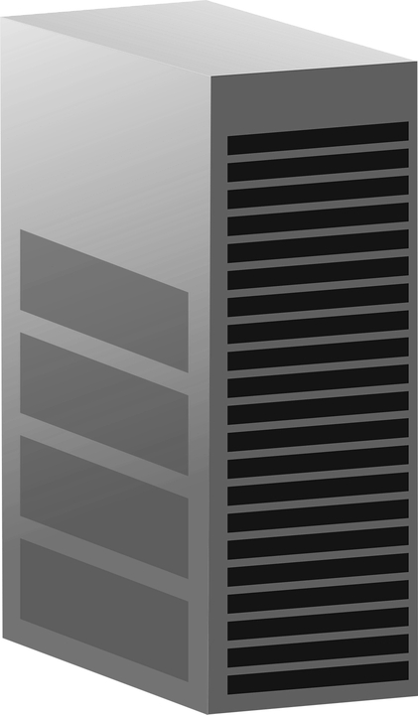

Write a definition
Starter activity
Server
Task
Last lesson you were introduced to the term ‘computer network’. See if you can now write a definition for the term ‘computer network’.
Explorer task
Define the term ‘peer-to-peer network’. Draw a diagram if this helps your explanation.
Client
Client
Client
Notes:
Image source: https://pixabay.com/vectors/server-computer-mainframe-146615/
Image source: https://pixabay.com/vectors/laptop-pc-computer-technology-2243898/

Slide 3
Write a definition
Starter activity
Define – computer network
A computer network is two or more computers connected together, sharing resources.
Define – peer-to-peer
A type of connection used in a network. Each device in a peer-to-peer network has equal responsibility. They can act as both client and server.
Server
Server
Server
Client
Client
Client
Server
Server
Server
Client
Client
Client
Notes:
Image source: https://pixabay.com/vectors/laptop-pc-computer-technology-2243898/

Slide 4

Lesson 2: The client–server model
Objectives
In this lesson, you will:
Describe the role of a computer in a client–server network
Describe the purpose of a PAN, LAN, and a WAN

Slide 5
Client–server model
Activity 1
Server
In the client–server model there are two main roles:
The client
The server
Clients make requests. This could be for all sorts of tasks like requesting files, accessing emails, or printing a document.
Servers fulfil the requests from the client.
Client
Client
Client
Notes:
Image source: https://pixabay.com/vectors/server-computer-mainframe-146615/
Image source: https://pixabay.com/vectors/laptop-pc-computer-technology-2243898/

Slide 6
Client–server model
Activity 1
Server
A server is often a powerful machine that carries out multiple requests from all of the clients on the network.
All requests go via the server, unlike a peer-to-peer network, where all of the devices can fulfill requests.
Client
Client
Client
Notes:
Image source: https://pixabay.com/vectors/server-computer-mainframe-146615/
Image source: https://pixabay.com/vectors/laptop-pc-computer-technology-2243898/

Slide 7
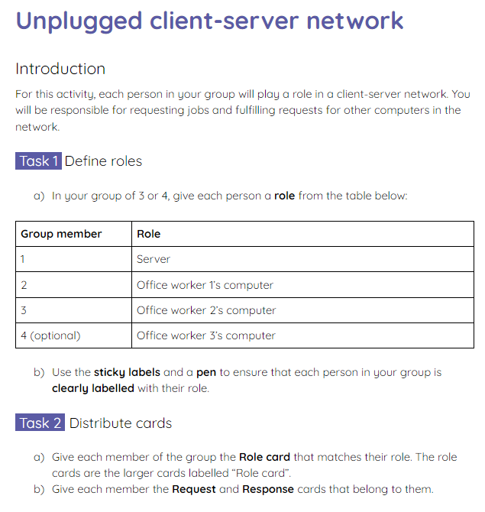
Client–server model
Activity 1
In groups of 3, you will take part in an unplugged activity where you act out various scenarios performed using the client–server model.
Read your instructions on the activity 1 sheet carefully to set up the task. Scenario one will be completed together using the following slides.

Slide 8

Scenario 1
Activity 1
Server
Office worker 1 sends a request for the file Company_logo.png
Server receives the request and sends the file Company_logo.png
Office worker 2 sends a print request for the file Annual_budget.xls
Server actions the print request from Office worker 2
Client
Client
Client
Notes:
Image source: https://pixabay.com/vectors/server-computer-mainframe-146615/
Image source: https://pixabay.com/vectors/laptop-pc-computer-technology-2243898/

Slide 9
Scenario 1
Activity 1
Server
(optional) Office worker 3 sends a request for the file Website_animation.gif
(optional) Server receives the request and sends the file Website_animation.gif
Office worker 1 sends a print request for the file Welcome_letter.doc
Server actions the print request from Office worker 1
Client
Client
Client
Notes:
Image source: https://pixabay.com/vectors/server-computer-mainframe-146615/
Image source: https://pixabay.com/vectors/laptop-pc-computer-technology-2243898/

Slide 10
Scenario 1
Activity 1
Server
Office worker 2 sends a request for the file Customer_database.db
Server receives the request and sends the file Customer_database.db
Office worker 1 requests to print Company_logo.png
Server actions the request to print Company_logo.png
Client
Client
Client
Notes:
Image source: https://pixabay.com/vectors/server-computer-mainframe-146615/
Image source: https://pixabay.com/vectors/laptop-pc-computer-technology-2243898/

Slide 11
The client–server model
Activity 1
Server
Now complete scenarios two and three in your individual groups.
After completing the scenarios, reflect on the advantages and disadvantages of using the client–server model.
Client
Client
Client
Notes:
Image source: https://pixabay.com/vectors/server-computer-mainframe-146615/
Image source: https://pixabay.com/vectors/laptop-pc-computer-technology-2243898/

Slide 12
Advantages and disadvantages
Activity 1
Server
Choose one person from your group to share the advantages and disadvantages that you identified whilst completing the activity.
Client
Client
Client
Notes:
Image source: https://pixabay.com/vectors/server-computer-mainframe-146615/
Image source: https://pixabay.com/vectors/laptop-pc-computer-technology-2243898/

Slide 13
Advantages and disadvantages: model answers
Activity 1
Server
Advantages:
All of the files are stored on one central server
All of the peripherals are processed via the server
If a client machine breaks it won’t affect the whole network
A backup can be taken of the server, rather than individual client machines
Client
Client
Client
Notes:
Image source: https://pixabay.com/vectors/server-computer-mainframe-146615/
Image source: https://pixabay.com/vectors/laptop-pc-computer-technology-2243898/

Slide 14
Advantages and disadvantages: model answers
Activity 1
Server
Disadvantages:
They are expensive to set up, compared to stand-alone computers or a peer-to-peer network
A specialist network administrator is required to set up the network
If the server fails, then everyone connected to that server is disrupted
Client
Client
Client
Notes:
Image source: https://pixabay.com/vectors/server-computer-mainframe-146615/
Image source: https://pixabay.com/vectors/laptop-pc-computer-technology-2243898/

Slide 15
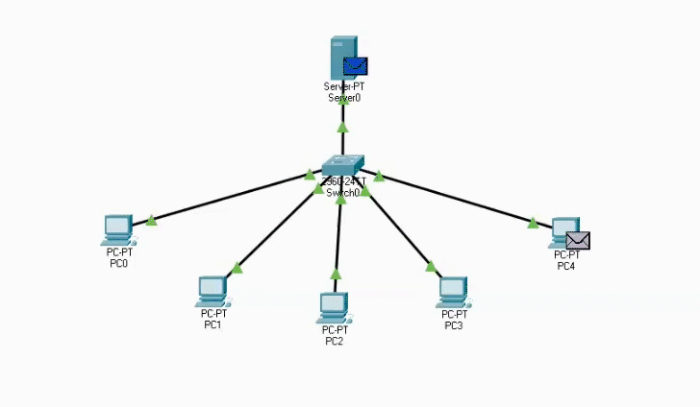
Client–server model simulation: Packet Tracer
Activity 1

Slide 16

Peer-to-peer vs client–server model
Activity 2
The client–server model is typically used where a central server is required.
For example, a business might need employees to share files and software. These are stored and accessed via the central server to allow for shared access.
Notes:
Image source: https://pixabay.com/photos/office-business-men-businessmen-1209640/

Slide 17

Peer-to-peer vs client–server model
Activity 2
Online gaming sites can often use a client–server model to provide shared access to an online environment.
All of the players access the gaming environment via the same server. This allows them to play together on the same game in real time.
Notes:
Image source: https://www.pexels.com/photo/a-woman-playing-video-game-7915492/

Slide 18
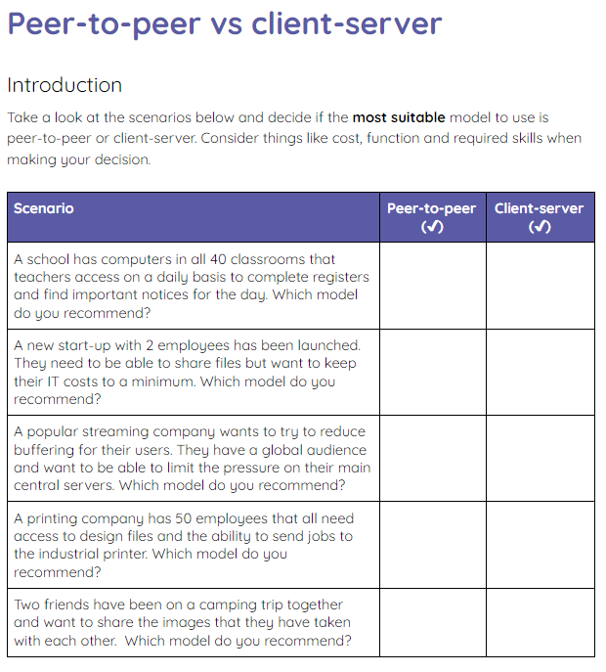
Peer-to-peer vs client–server model
Activity 2
Read the scenarios on the activity 2 sheet and decide if the people should use the peer-to-peer model or the client–server model.

Slide 19
PANs, LANs, and WANs
Activity 3
The two most common models for a computer network are peer-to-peer and client–server.
You can also describe a network by the type of area that they operate in.
Firstly, there is a Personal Area Network or PAN.
This is typically limited to a single user in the network with multiple connected devices.

Slide 20

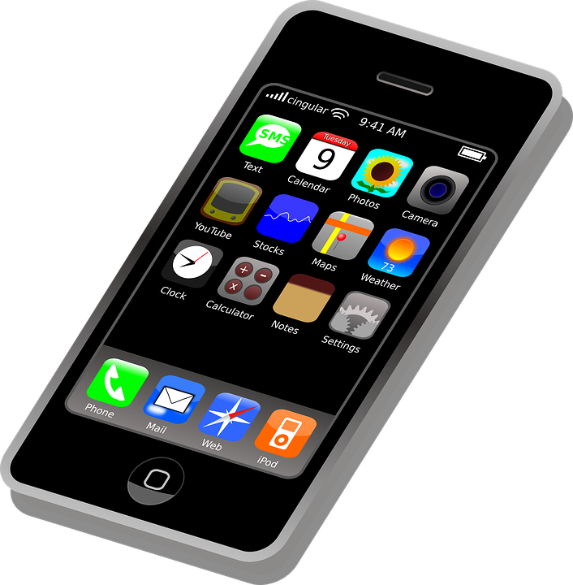
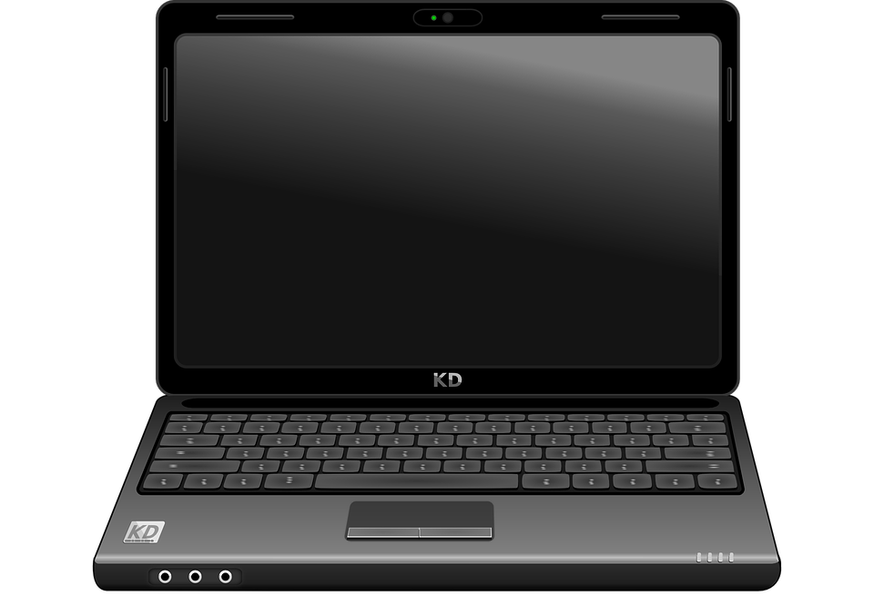
Personal area network (PAN)
Activity 3
A single user might have a laptop that is connected to a smartphone to share the internet access.
The user might also have a smartwatch that is connected to the smartphone to track heart rate, steps, and notify the user of new messages.
Notes:
Smartwatch image: https://pixabay.com/vectors/watch-wristwatch-time-clock-2649380/
Laptop image: https://pixabay.com/vectors/laptop-notebook-computer-black-158648/
Smartphone image: https://pixabay.com/vectors/iphone-cellphone-smartphone-mobile-37856/

Slide 21
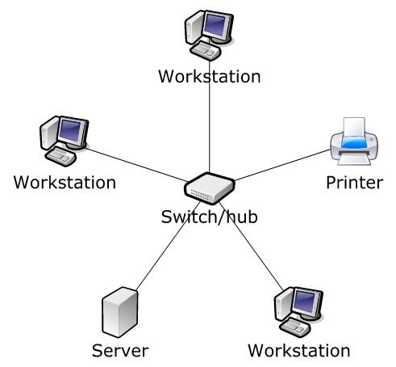
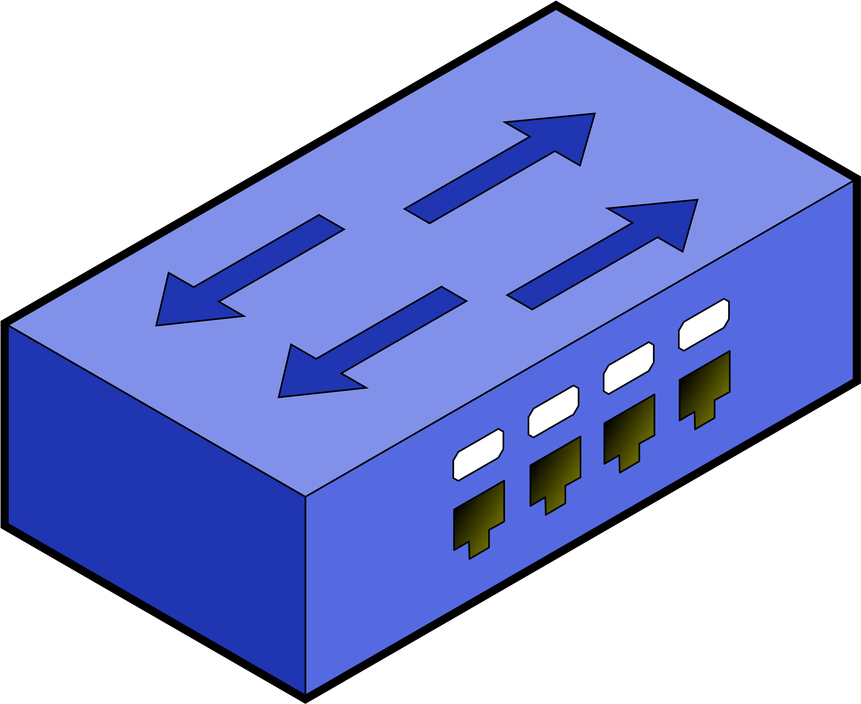
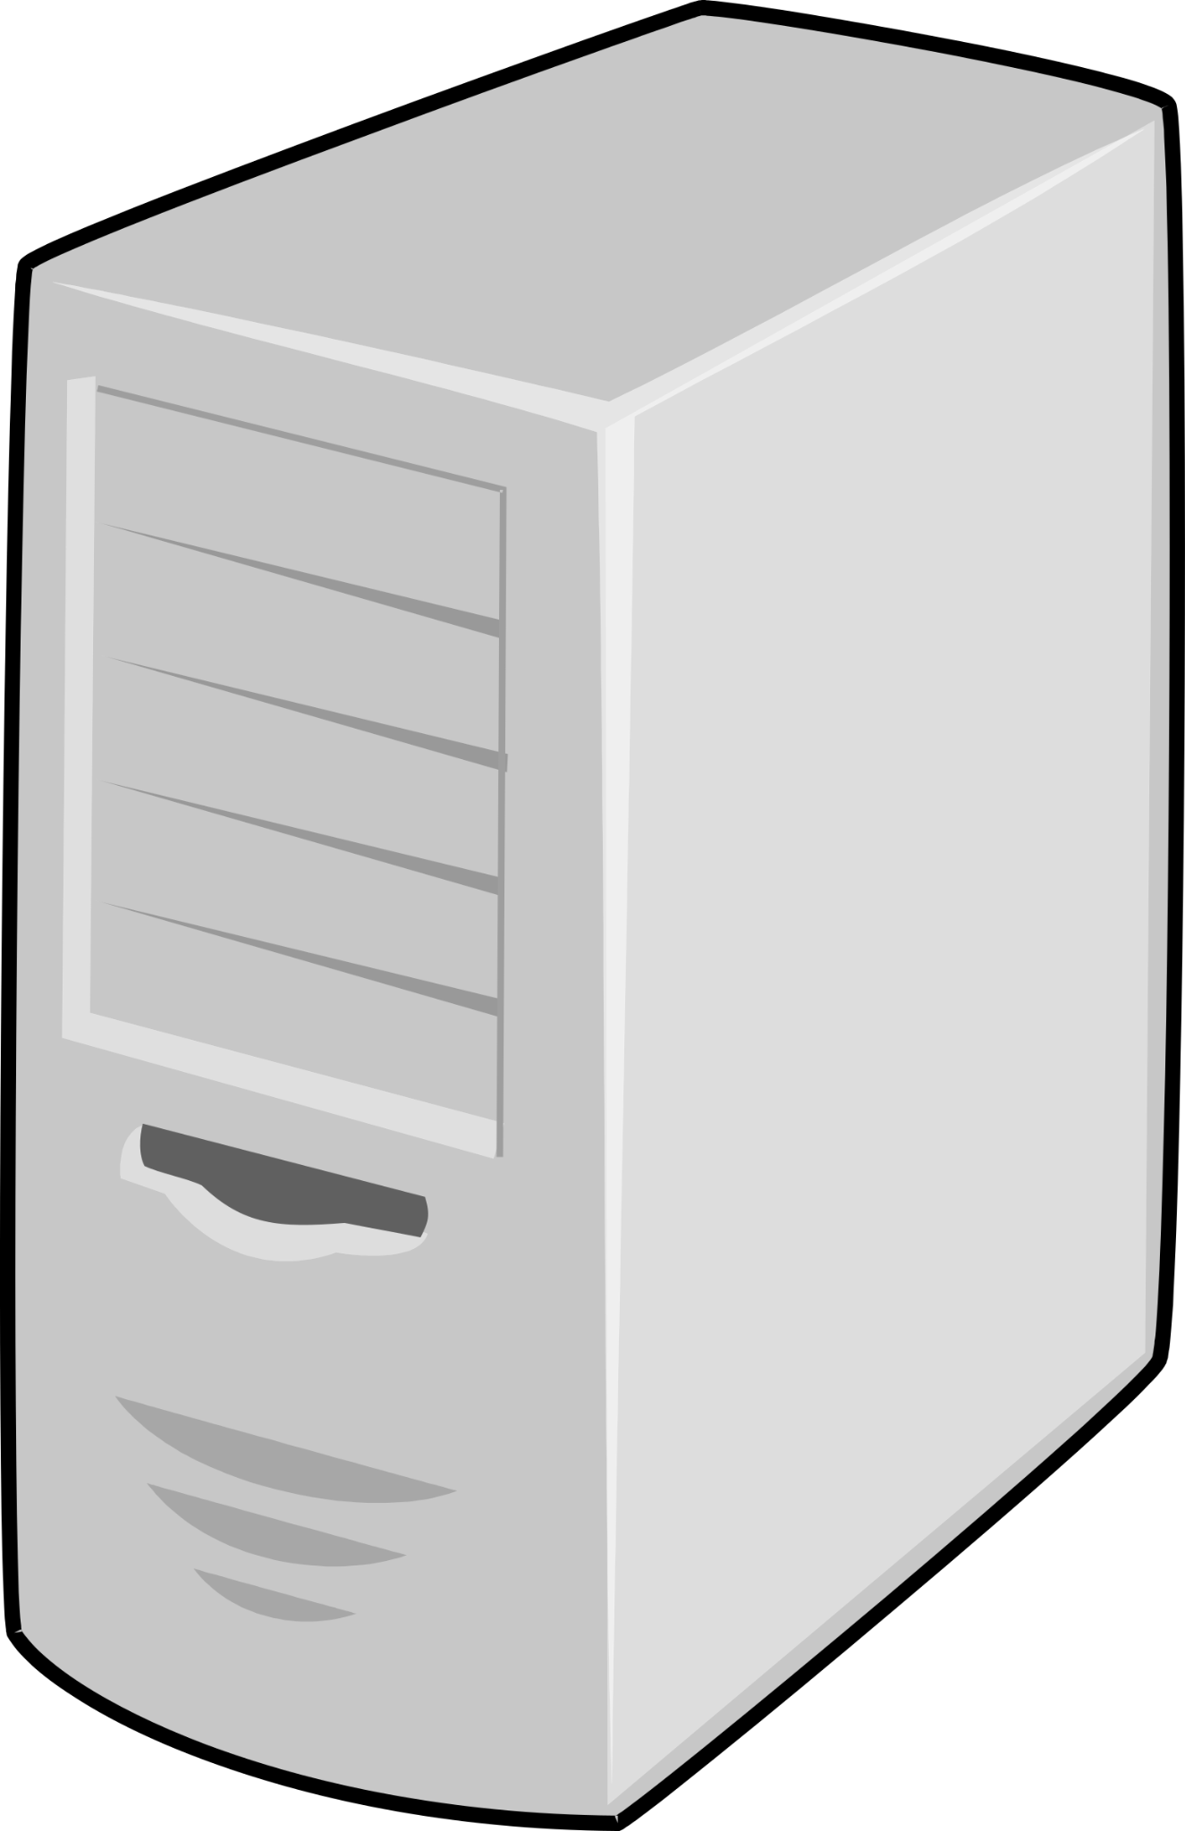
Local area network (LAN)
Activity 3
The second type of area network is a Local Area Network or LAN.
A LAN has multiple users and is typically situated in a single building or room. The devices on the network are ‘local’ to each other.
A small office will typically use a LAN to allow for shared access to files and peripherals.
Notes:
Image sources:
https://www.clipartmax.com/middle/m2i8H7b1K9A0i8H7_open-thin-client-icon/
https://www.clipartmax.com/middle/m2i8Z5K9K9H7H7b1_possible-printer-issue-fix-printer-icon/
https://www.clipartmax.com/download/m2H7K9d3K9Z5A0m2_switch-with-border-network-switch-clipart/
https://www.clipartmax.com/download/m2i8i8b1b1A0d3G6_server-server-png/

Slide 22
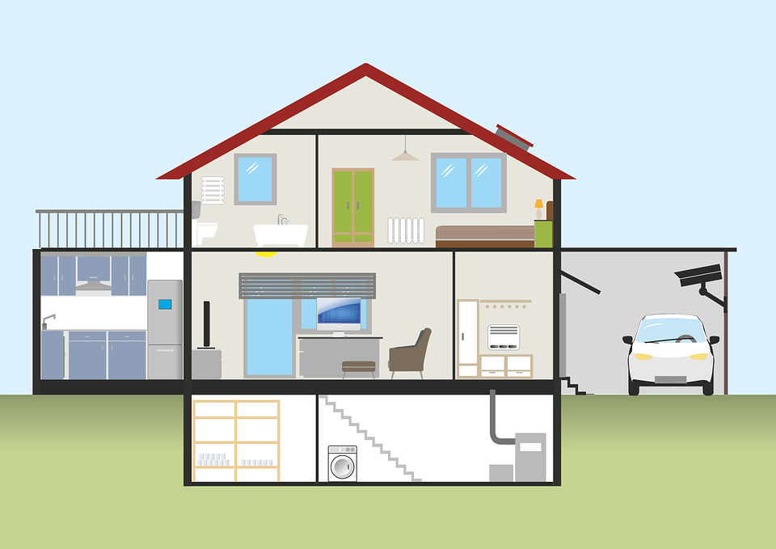
Local area network (LAN)
Activity 3
You might also see a LAN in a household. Members of the household might have laptops, smartphones, computers, and even TVs and smart devices all connected via a LAN.
Notes:
Image source: https://pixabay.com/illustrations/house-plank-garage-auto-keller-2006023/

Slide 23
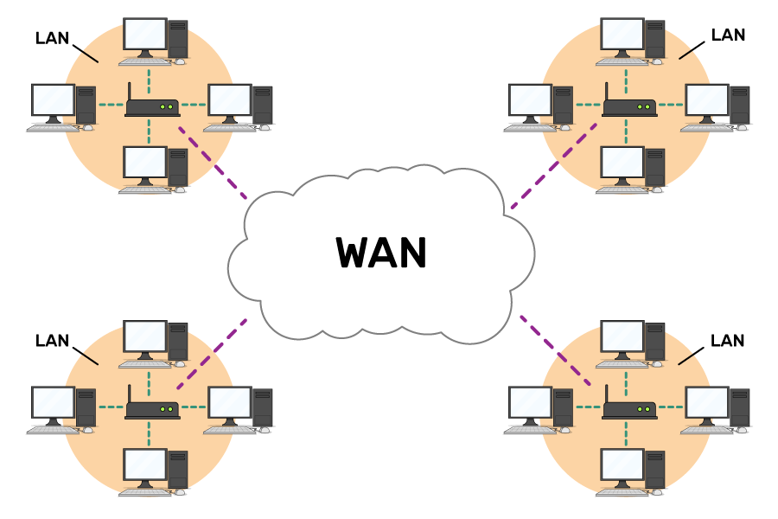
Wide area network (WAN)
Activity 3
The final type of computer network is a Wide Area Network or WAN. When devices are connected across a wider geographical area, they form a wide area network (WAN).
Often, lots of LANs are connected together to create a WAN.
Notes:
Image source: Raspberry Pi online course (futurelearn)

Slide 24

Wide area network (WAN)
Activity 3
Large businesses use WANs to share files and resources across multiple buildings in different locations.
They might have an office in Wales and and an office in Scotland, both requiring access to shared files. A WAN can make this possible.
Office 1
Office 2
Notes:
Image source: https://pixabay.com/vectors/united-kingdom-map-great-britain-36481/

Slide 25
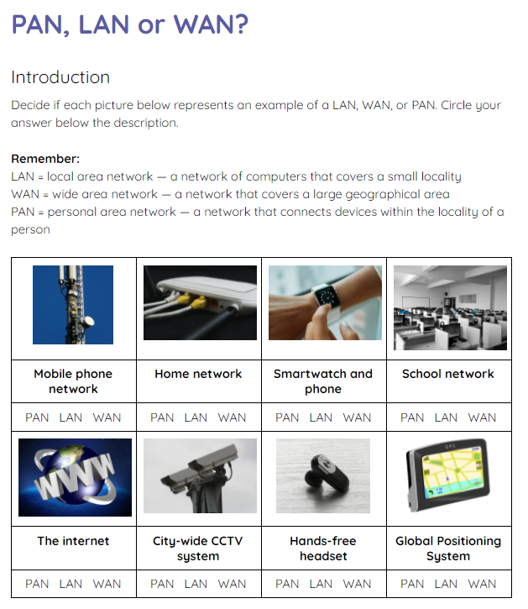
PANs, LANs, and WANs
Activity 3
Use the activity 3 sheet to decide if the image represents a PAN, a LAN, or a WAN.

Slide 26
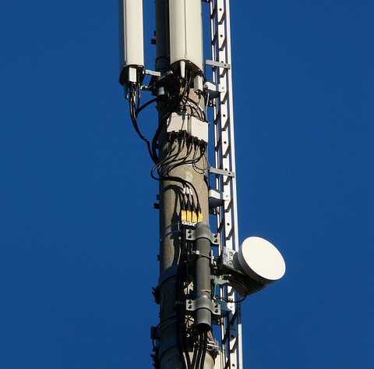
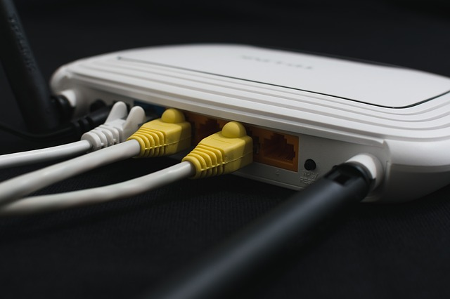
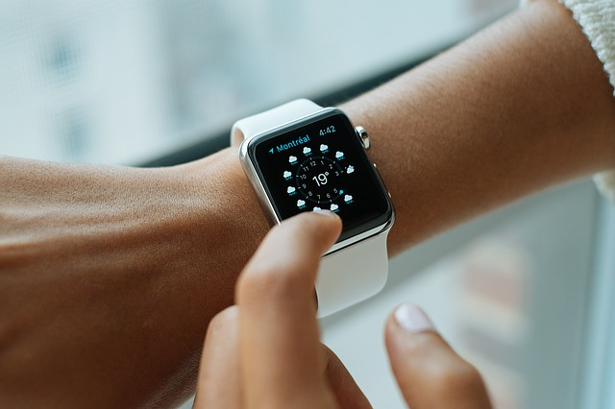
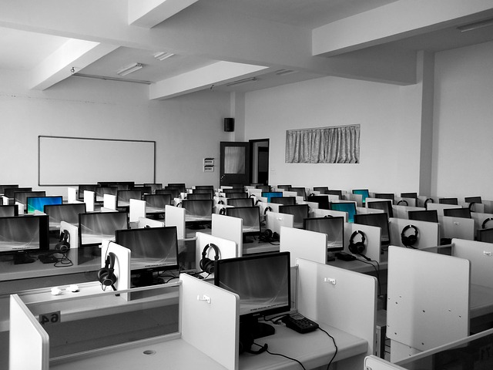
PANs, LANs, and WANs: solutions
Activity 3
Mobile phone network | Home network | Smartwatch and phone | Single-site school network
WAN | LAN | PAN | LAN
Notes:
Image sources:
https://pixabay.com/photos/transmission-tower-radio-tower-tower-61748/
https://pixabay.com/photos/wireless-home-router-adsl-modem-1861612/
https://pixy.org/77358/
https://pixabay.com/photos/language-lab-college-university-181083/

Slide 27

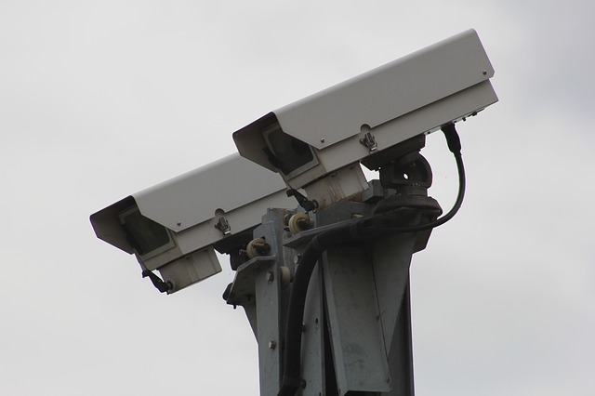

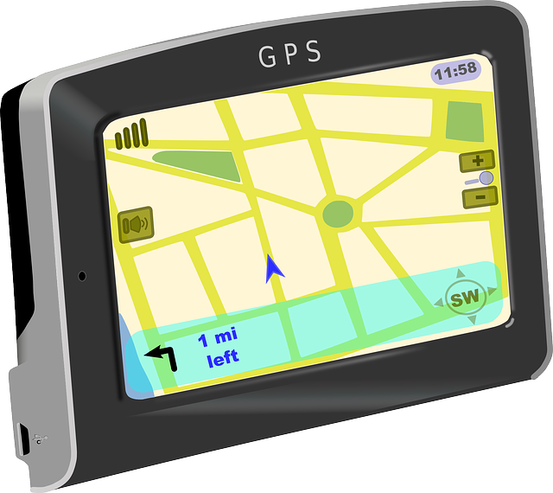
PANs, LANs and WANs: solutions
Activity 3
The internet | City-wide CCTV system | Hands-free headset | Global positioning system
WAN | WAN | PAN | WAN
Notes:
Image sources:
https://pixabay.com/photos/macbook-laptop-google-display-459196/
https://pixabay.com/photos/security-camera-camera-security-834173/
https://pixabay.com/photos/handsfree-earphone-vote-microphone-1267605/
https://www.pngwing.com/en/free-png-vexqd

Slide 28
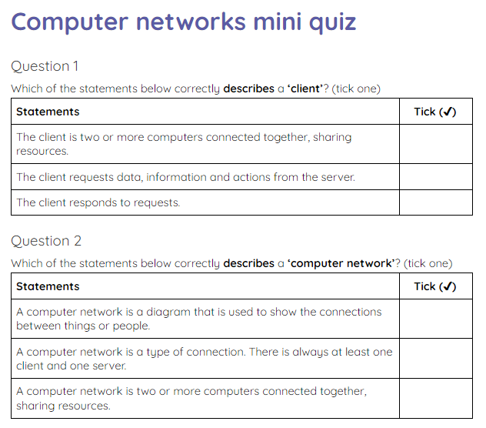
Computer networks mini quiz
Plenary
Use the activity sheet to complete a short quiz to test your knowledge and understanding from the last two lessons.

Slide 29
Next lesson
Summary
In this lesson, you…
Described the role of a computer in a client–server network
Described the purpose of a PAN, LAN, and a WAN
Next lesson, you will…
Describe the tasks performed by the network hardware: wireless access point, router, switch, hub, NIC, and bridge

